Slide 1
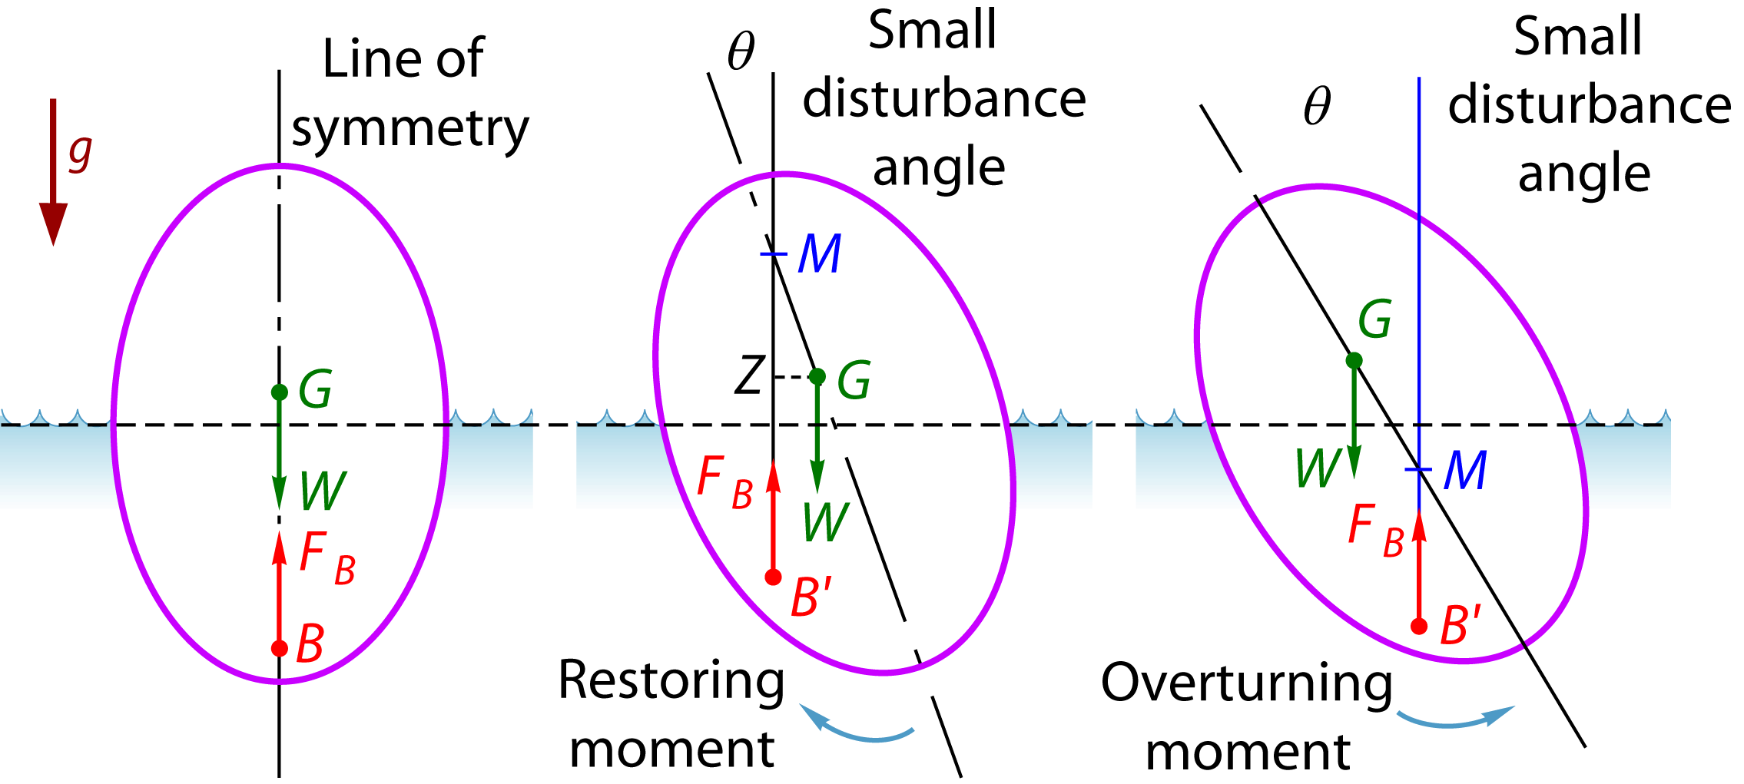
3.8.3 Stability of Floating Bodies
As floating body rotates,
location of the center of buoyancy B (which passes through centroid of the displaced volume) may change: B ⇨ B’
location of center of gravity G of body remains unchanged

Slide 2

3.8.3 Stability of Floating Bodies
Metacenter M ⇨ point of intersection of original vertical axis with line of action of buoyancy force after an angle of heel θ
Metacentric height GM
determines stability of floating body
important parameter in design of floating bodies
need to determine GM_{T} (transverse metacentric height) corresponding to roll (angular displacement about y-axis) and GM_{L} (longitudinal metacentric height) corresponding to pitch (angular displacement about x-axis) for different water levels before construction of floating body

Slide 3
3.8.3 Stability of Floating Bodies
(i) M above G ⇨ GM > 0 ⇨ Stable equilibrium
Restoring couple acts on floating body in its displaced position tending to restore it to its original position
Restoring couple =
(GZ is called the righting arm)

Slide 4
3.8.3 Stability of Floating Bodies
(ii) M below G ⇨ GM < 0 ⇨ Unstable equilibrium
Overturning couple acts on body
(iii) M coincides with G ⇨ GM = 0 ⇨ Neutral equilibrium
Zero resultant couple ⇨ body has no tendency to return to, nor move further away from original position
Stability of floating body is not simply determined by relative positions of B and G, unlike submerged bodies

Slide 5
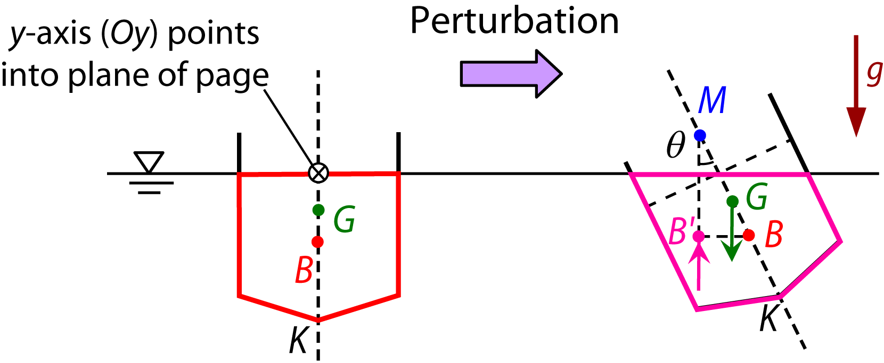
3.8.3 Stability of Floating Bodies
For an upright vessel, point of buoyancy (buoyancy center) is at B
B is centroid of volume of fluid displaced by floating body (and is shape dependent)
Vessel is given a slight angular perturbation θ ⇨ center of buoyancy shifts: B ⇨ B’
B and B’ are centroids of volume of displaced fluid before and after perturbations, respectively

Slide 6
3.8.3 Stability of Floating Bodies
Determination of GM – main result
From geometry,
where KB and KG can be obtained from center of gravity and buoyancy calculations, and BM is known as the metacentric radius, which is given by (see suppl. slides)
I_{Oy} ⇨ second moment of area of the plane of floatation (water line cross section) about the Oy-axis
V_{sub} ⇨ volume of submerged portion of floating body (displaced volume)
Plane of flotation refers to water plane
(3.8.1)
(3.8.2)
(3.8.3)
Notes:
We will come back to the derivation of (3.8.3) later

Slide 7
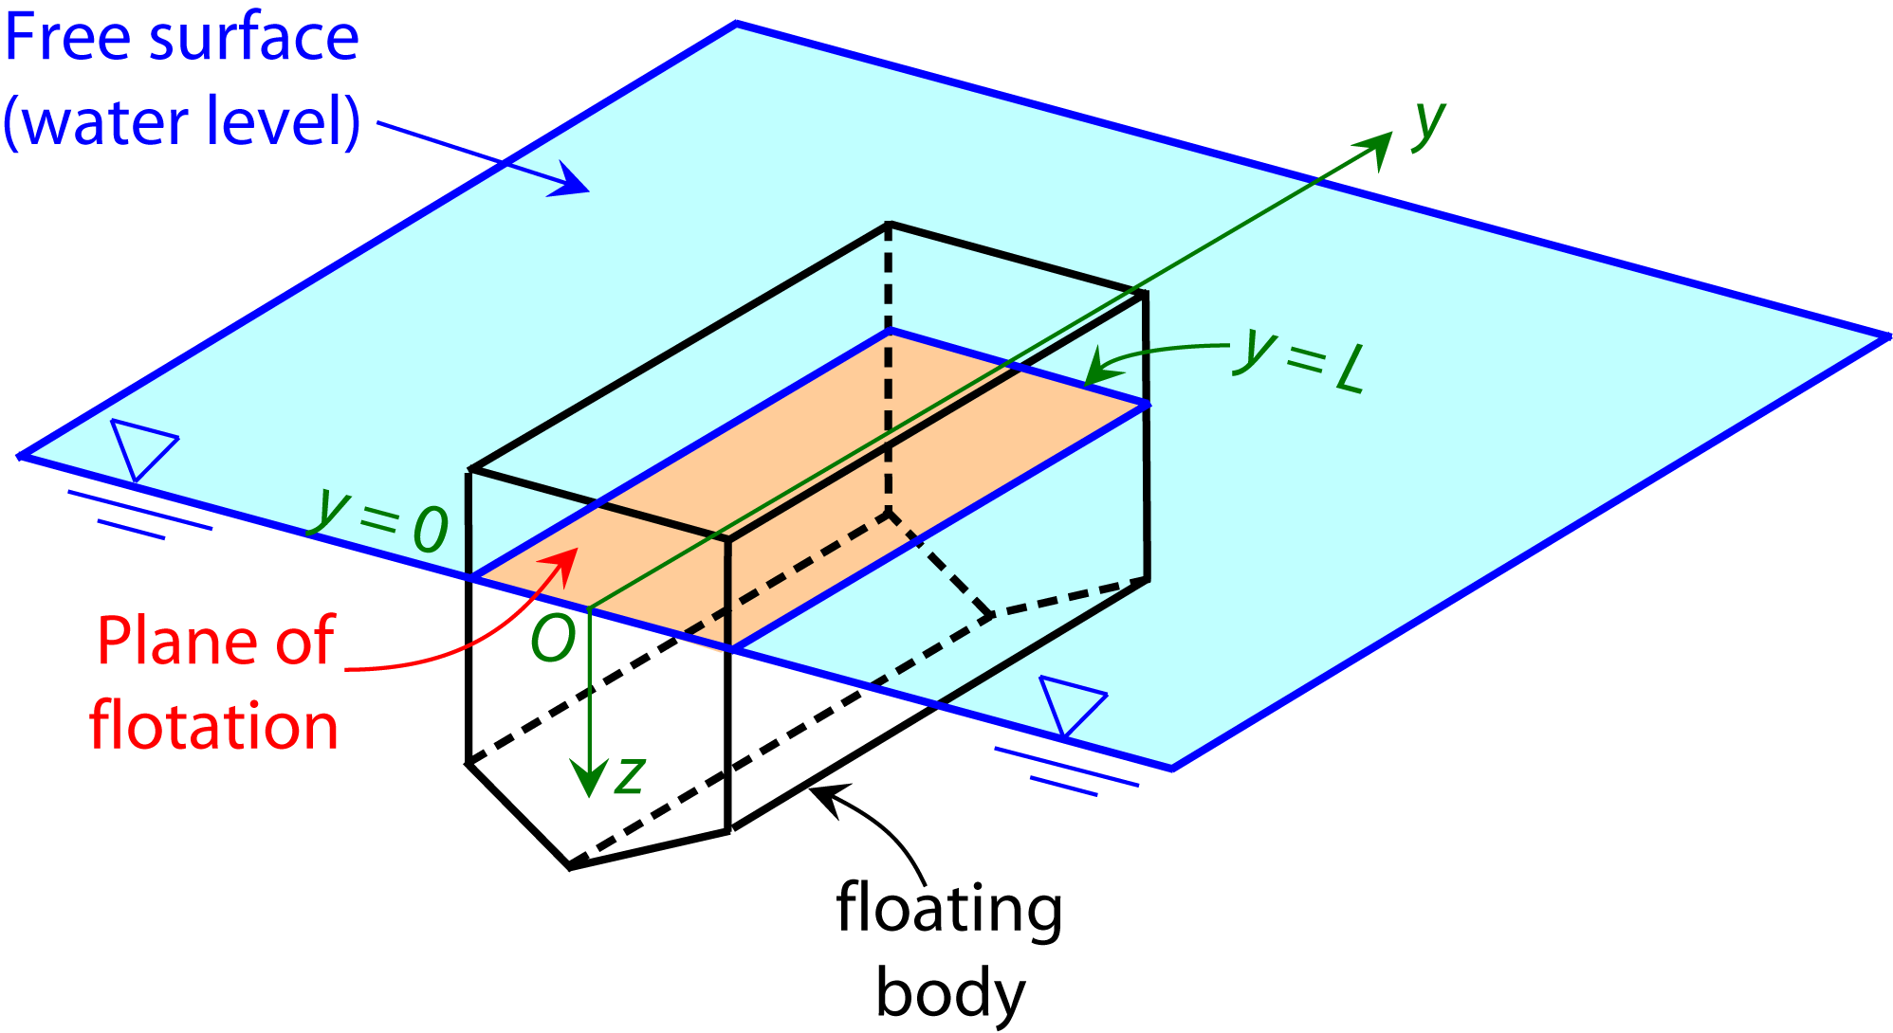
3.8.3 Stability of Floating Bodies
Plane of flotation:
Rolling about y: rolling
Rolling about x: pitching
Rolling about z: yawing

Slide 8
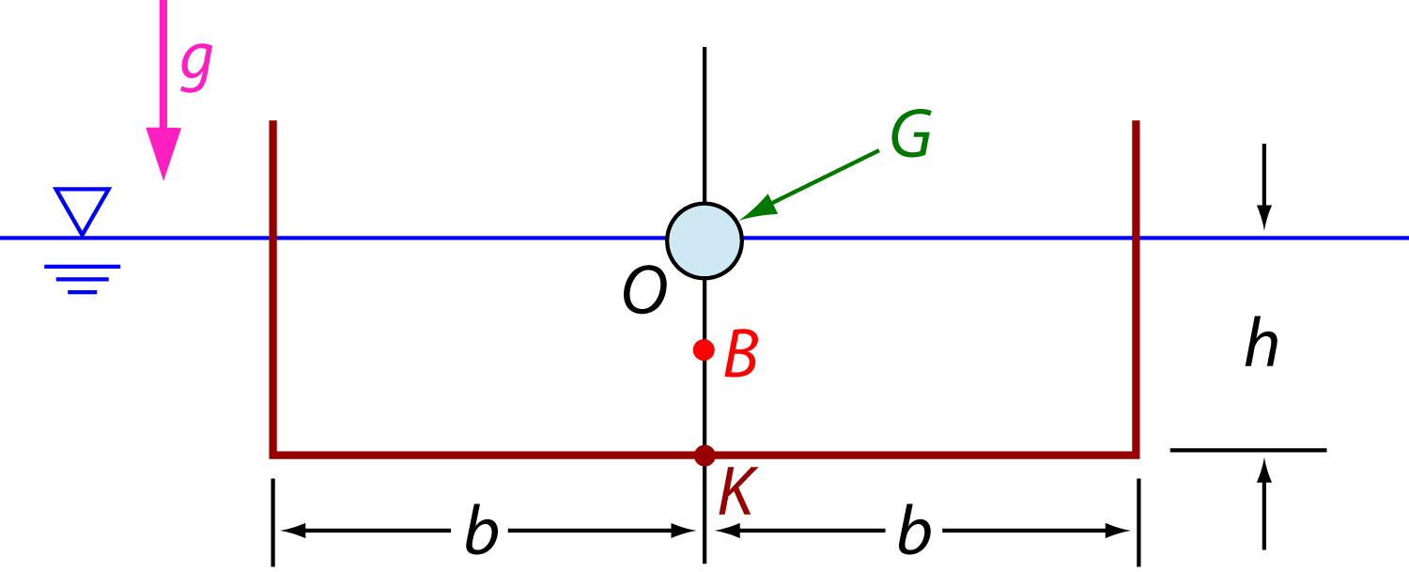
Example 3.8
Barge has uniform rectangular cross section of width 2b and vertical draft of height h
G is exactly at waterline
Determine
Metacentric height
Range of ratio b/h for which barge is stable

Slide 9
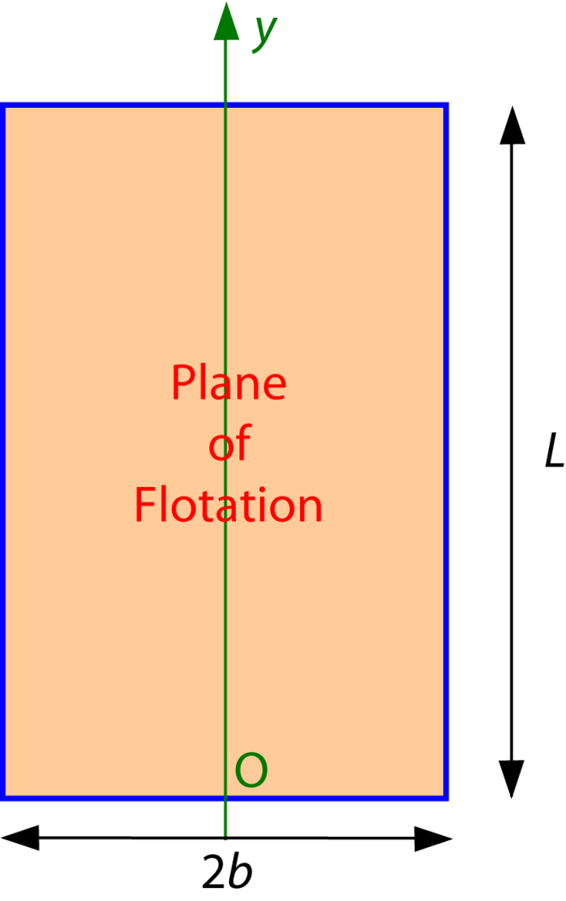

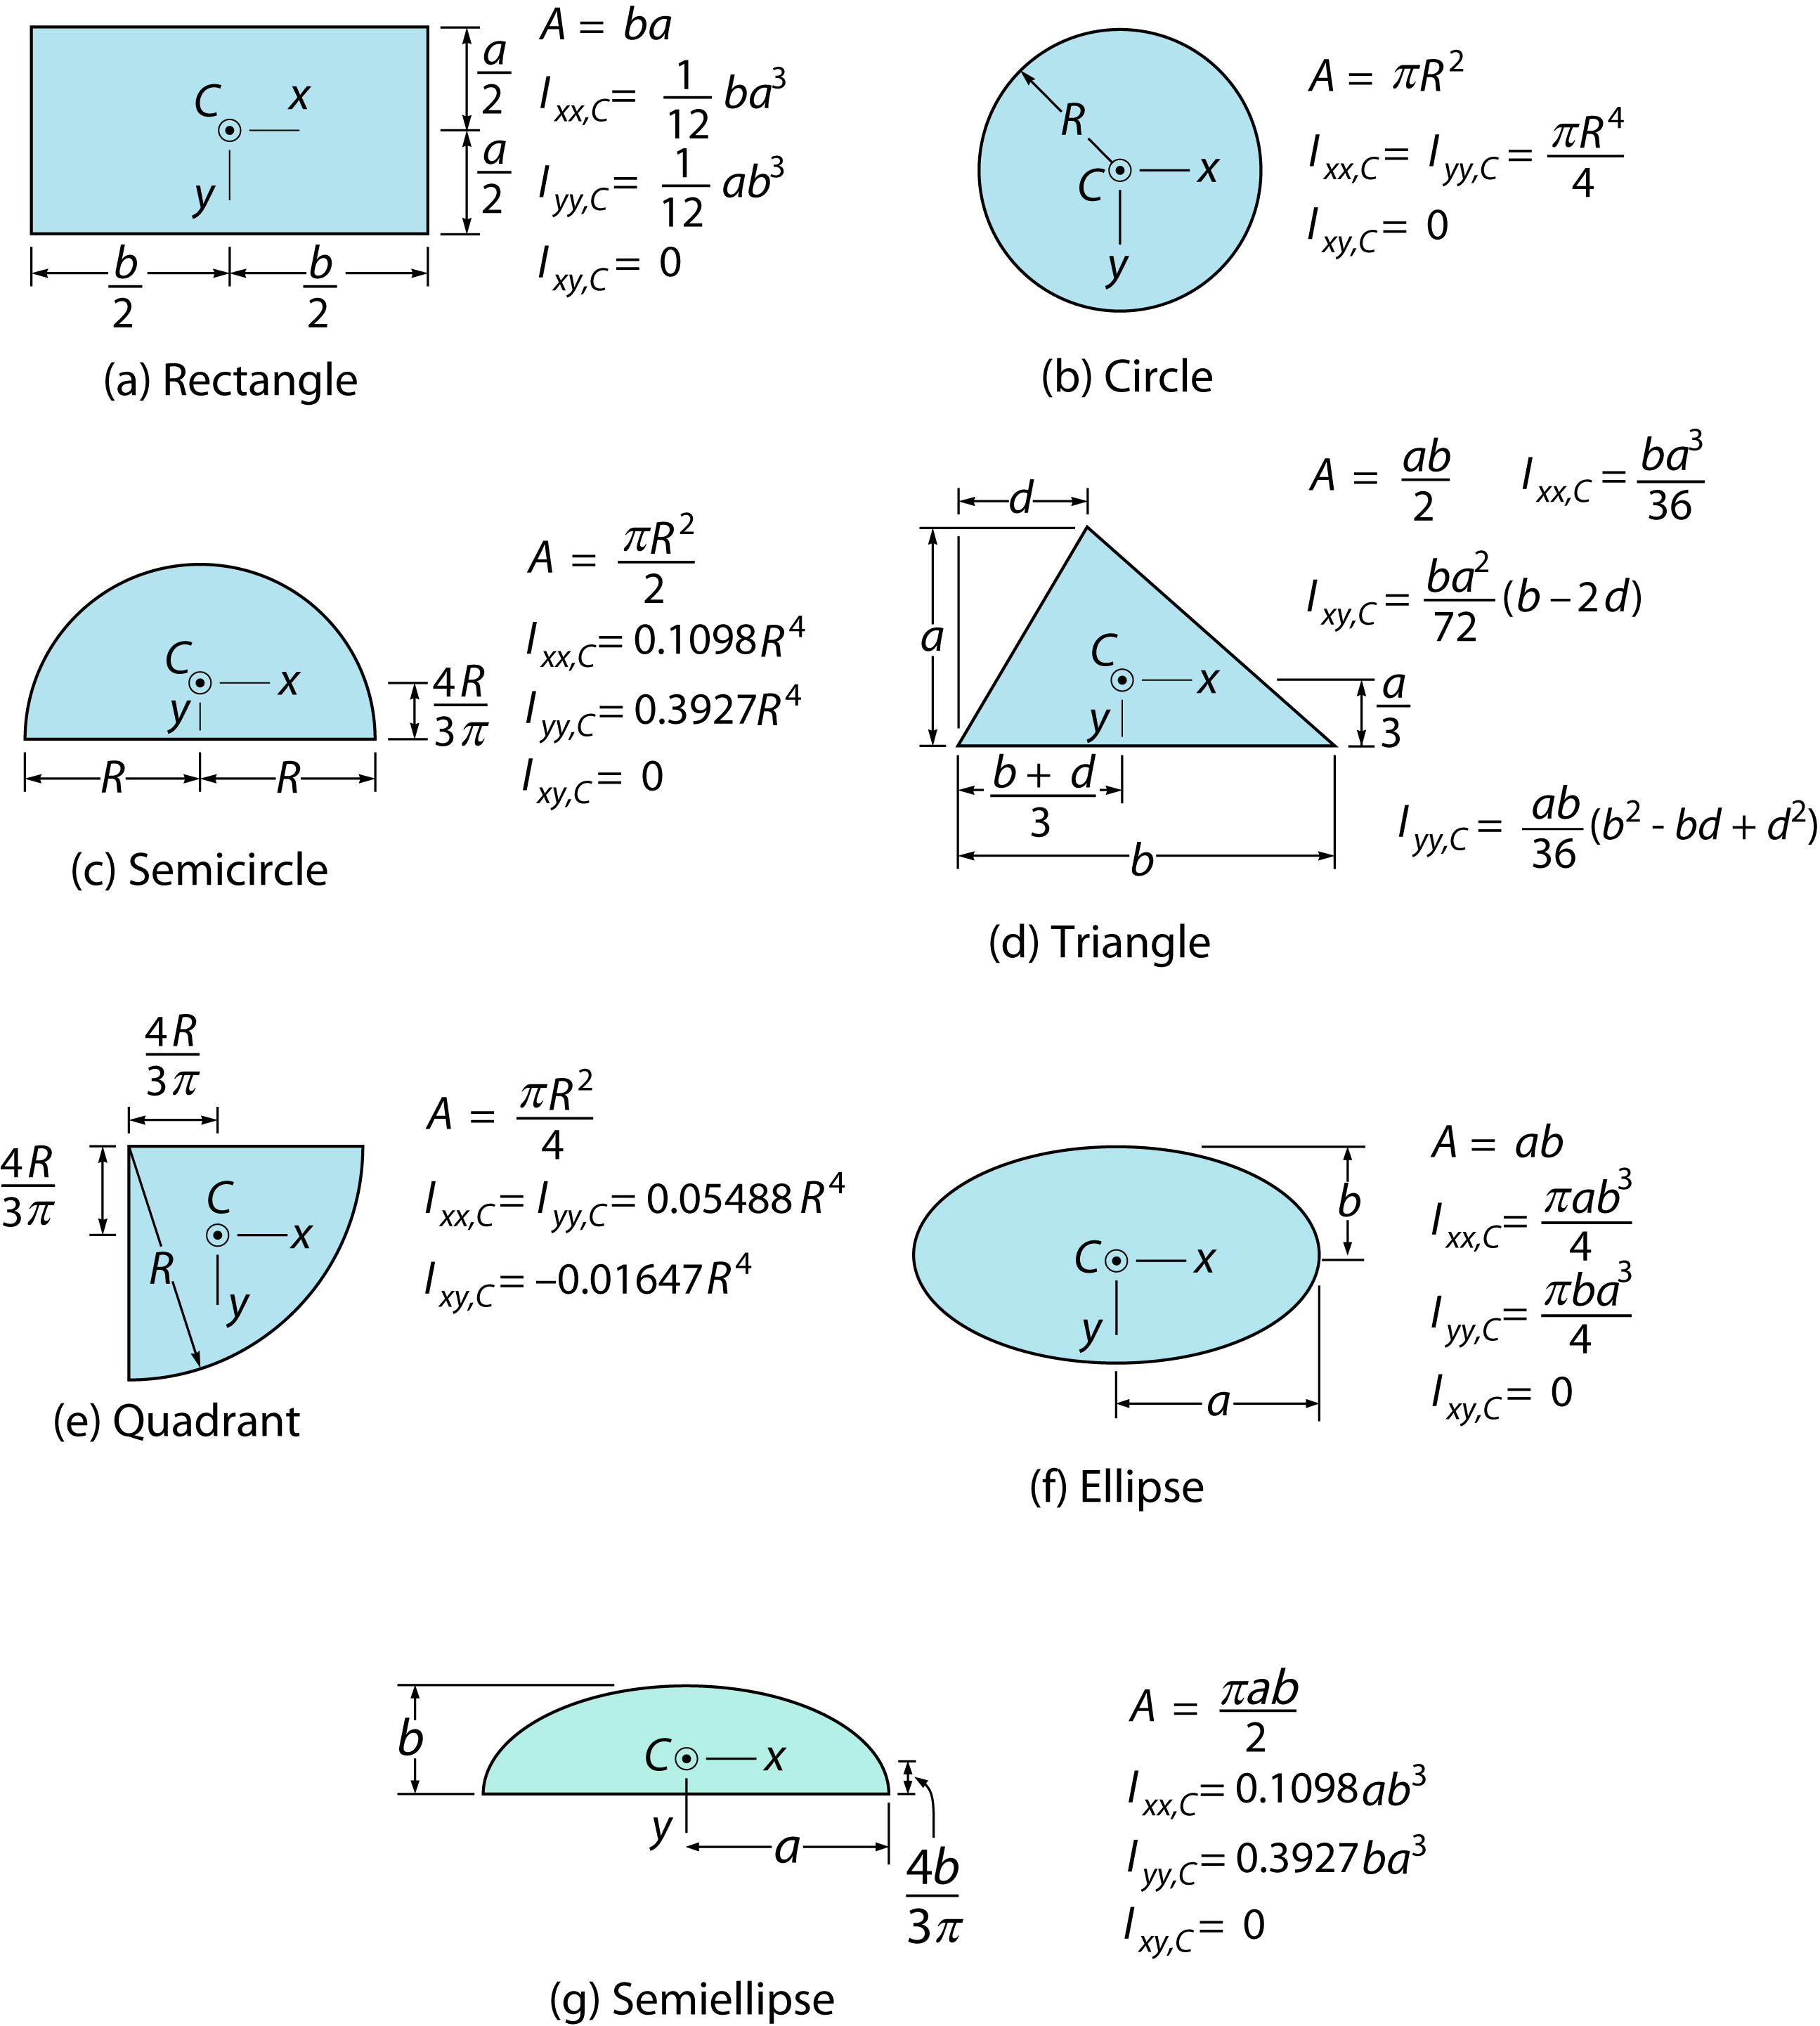
Example 3.8
Solution:
Assuming barge has length L into paper ⇨ plane of flotation is a rectangle with base L and height 2b

Slide 10

Example 3.8
Metacentric height:
For stability:
Barge wider relative to draft ⇨ stability improves
Lowering G also improves stability

Slide 11
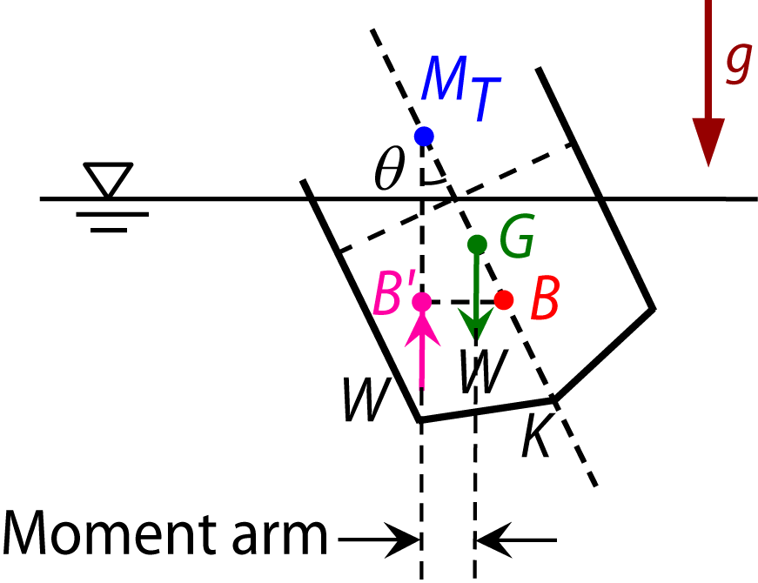
3.8.3 Stability of Floating Bodies
The following concepts in the following slides will be covered in lecture – they are necessary in understanding the Lab work
Motion of a body consists of a translational of the centre of mass, and a rotational motion; for vibration analysis purpose, we need only to consider rotational motion
This is governed by Newton’s law: moment of inertia (J_{Oy}) about Oy times angular acceleration = external moments
O
y
Negative sign arises because couple acts so as to decrease θ
Moment arm =

Slide 12
3.8.3 Stability of Floating Bodies
This is the equation of simple harmonic motion with angular frequency ω given by
and period of oscillation
As GM_{T} increases, ω increases, or T decreases (higher frequencies lead to discomfort)

Slide 13
3.8.3 Stability of Floating Bodies
Factors affecting selection of GM_{T}
(a) GM_{T} should be large enough:
in a passenger ship to prevent capsizing due to large heel (roll) angle in case of partial flooding
to minimize serious heeling due to strong beam wind
to render a ship stable for various cargo loading conditions
to prevent large heeling angles during turning
(b) GM_{T} should be small enough to prevent violent rolling in waves

Slide 14
3.8.3 Stability of Floating Bodies
Notes:
Ship with large GM_{T} is called a stiff ship ⇨ greater stability but shorter period of roll T ⇨ vessel less comfortable for passengers and is subjected to strains which may damage its structure
Cargo vessels ⇨ GM varies with loading although some control of its value is possible by adjusting position of cargo
Warships and racing yachts ⇨ larger GM because stability more important than comfort

Slide 15
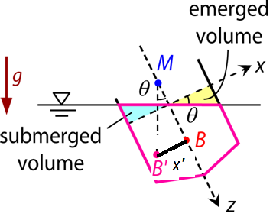
3.8.3 Stability of Floating Bodies
Evaluation of BM
Tilting the body by a small angle θ submerges a small wedge (green) and uncovers an equal wedge (yellow)
New center of buoyancy B’
Notes:
Tilting the body a small angle θ submerges a small wedge (green) and uncover an equal wedge (yellow).

Slide 16
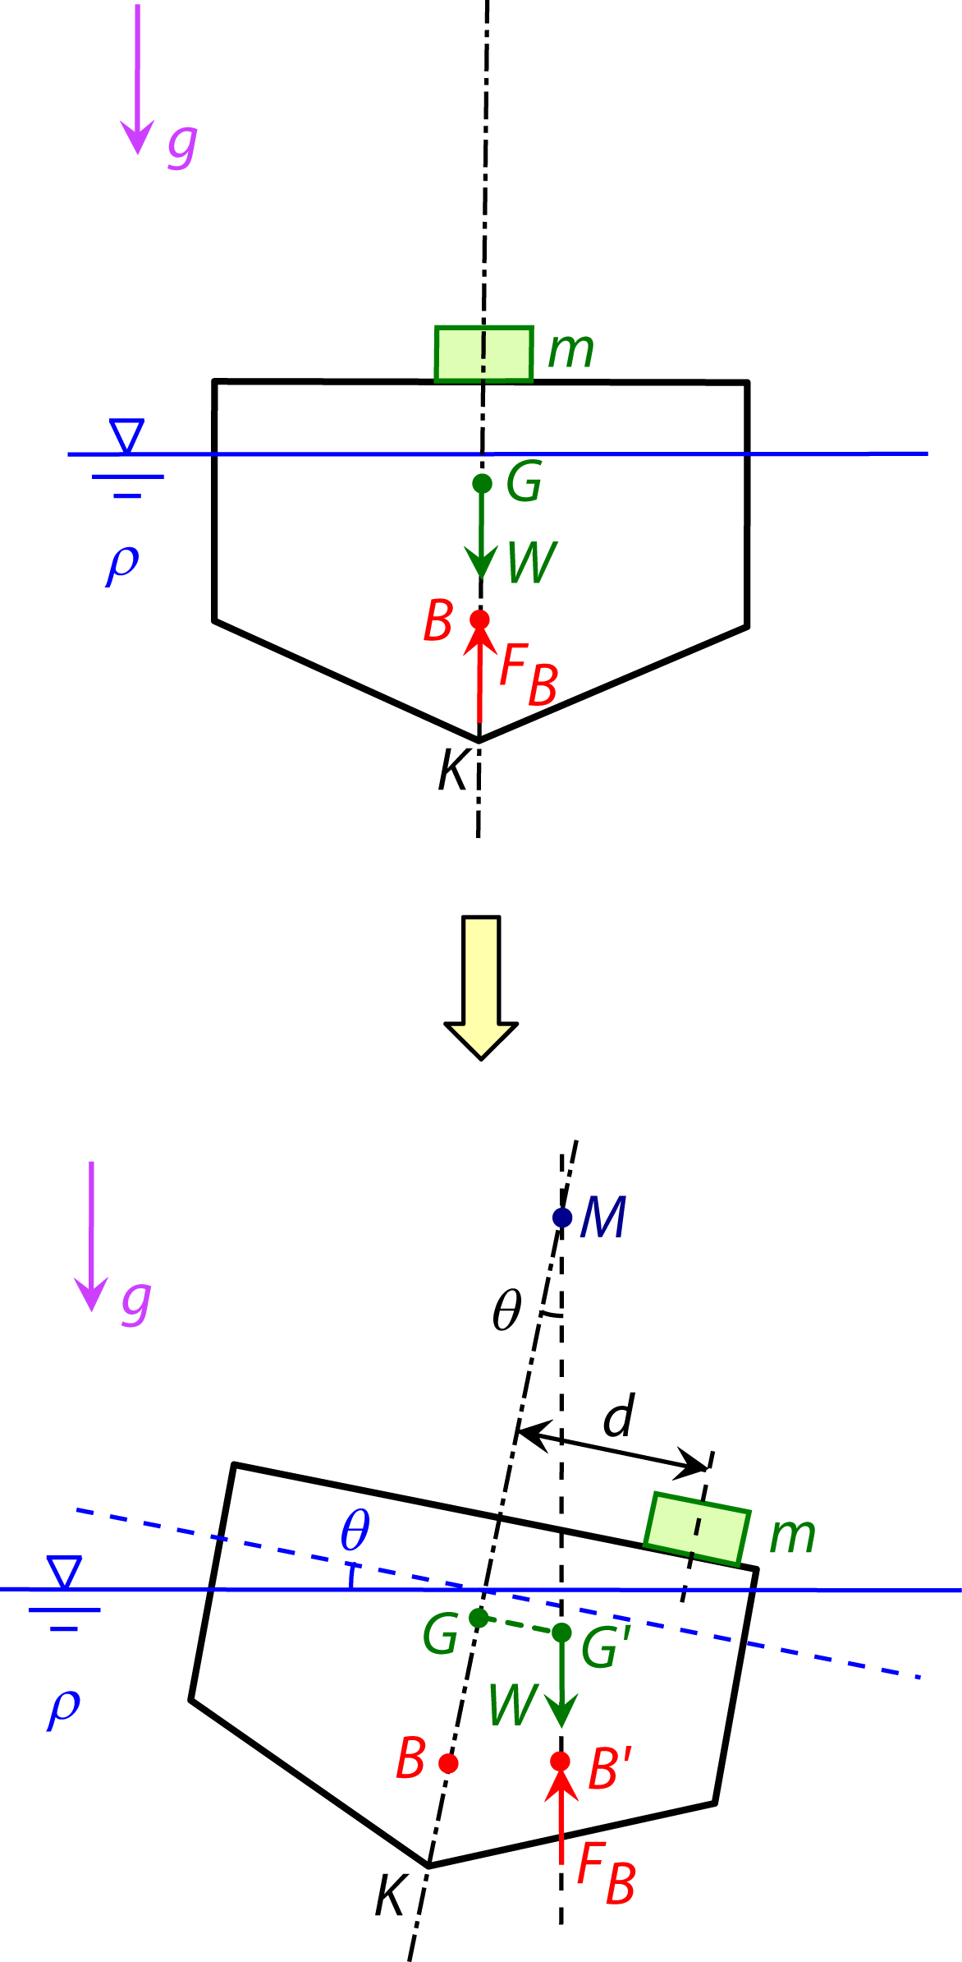
Moving weight in a floating body
If a weight is shifted transversely through a distance d then the centre of gravity of the ship is shifted to G’.
The ship then heels through an angle θ causing the buoyancy force to mover to B’ vertically collinear (colinear because there is no longer roll tendency) with the body weight to restore equilibrium

Slide 17
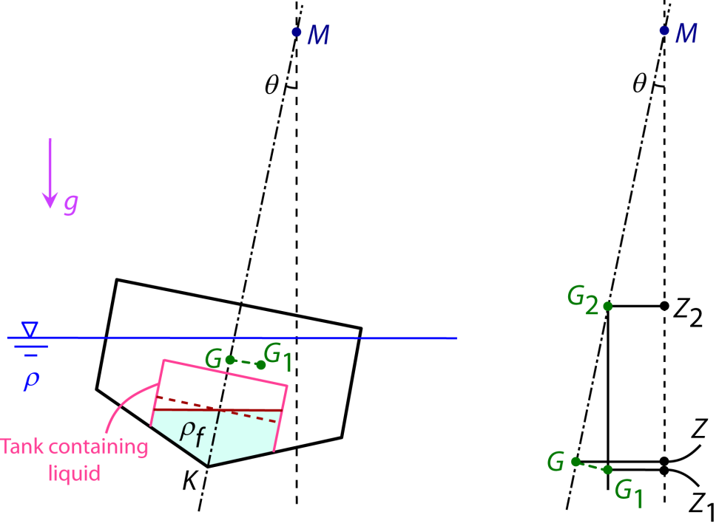
Partially-filled tank on a floating body
This usually occurs in ship carrying tanks partially filled with liquids. In a quasi-static situation, and avoiding sloshing, the free surface in the tanks adopt a horizontal position. The centre of buoyancy (or the centroid) of the liquid tank is shifted by a distance just like what we calculated before
where I₁ is the second order moment of area for the floatation plane of the tank, and V_{sub,t} is the “submerged” volume of the tank. The moment due to the shift in this centre is
This causes a shift in the centre of mass of the floating body (W: weight of body):

Slide 18
Partially-filled tank on a floating body
The effect is to reduce the righting moment arm (originally GZ) by an amount GG₁ to G₂Z₂ as seen in the figure
This is equivalently an effective (virtual) reduction of the metacentric height from GM to G₂M – a reduction in stability
The righting moment is now
where W is the weight of the body (also the buoyancy force). The “loss” of metacentric height GM being

Slide 19
Reviewing
Pressure in a fluid is independent of shape or cross section of container
Pressures changes with vertical distance (depth), but remains constant in other directions
Pressure is the same at all points on a horizontal plane in a given fluid
Easier to remember:
where is the absolute difference in depth between the two points of interest

Slide 20
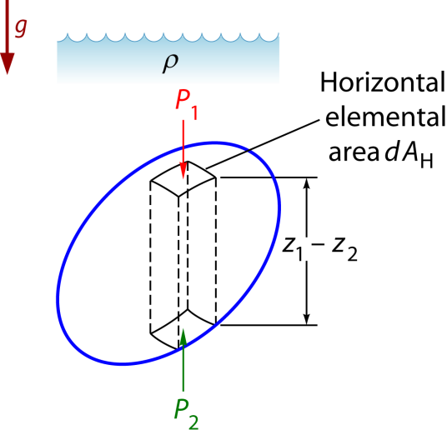
Reviewing
Archimedes Principle:
A body immersed in a fluid experiences a vertical buoyant (upthrust) force equal to the weight of the fluid it displaces
Center of buoyancy B may or may not correspond to actual mass center of immersed body’s own material
For stability the metacentre must be above the center of gravity or GM > 0

Slide 21
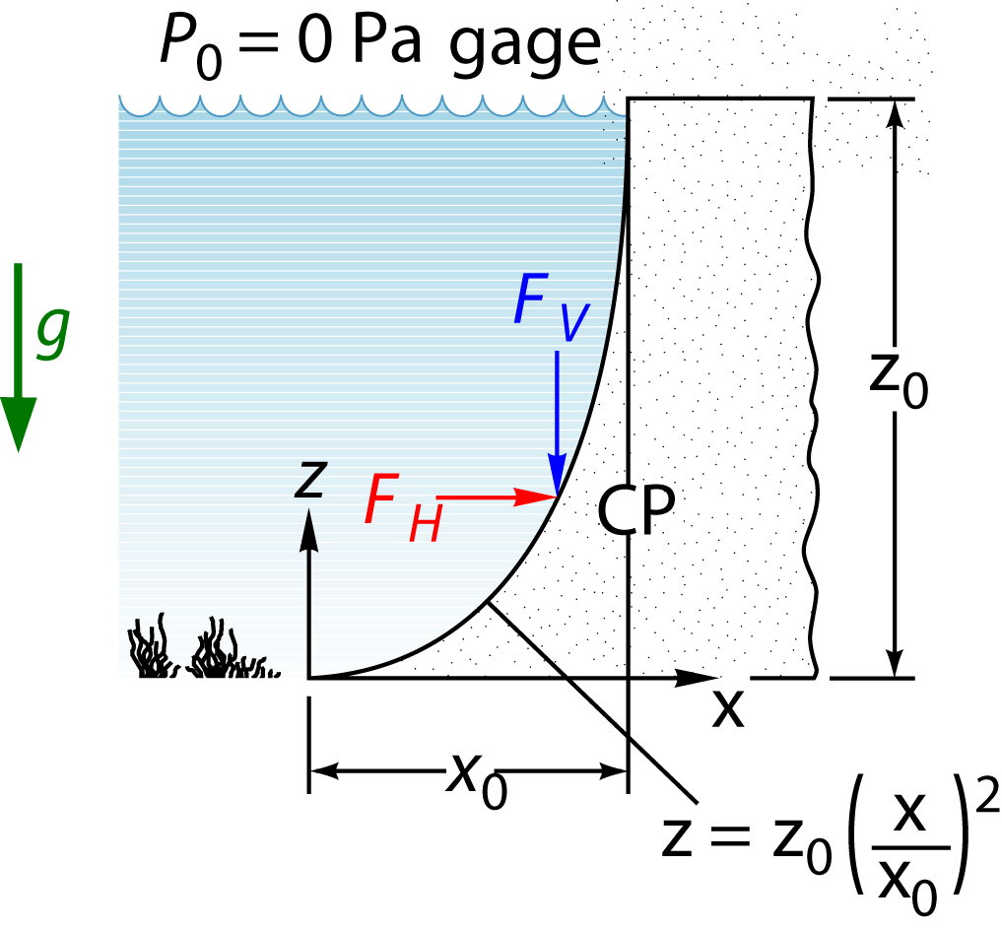
Example 3.5
Dam with parabolic shape
x₀ = 10 m, z₀ = 24 m
Fluid: water (ρ = 1000 kg/m³)
Omit atmospheric pressure (P₀ = 0 Pa gage)
Find F_{H} and F_{V} acting on dam and position CP where they act
Width of dam: b = 100 m

Slide 22
Example 3.5
Solution:
Vertical projection of curved surface is a rectangle 24 m high and 100 m wide
Depth of centroid:
y_{C} = h_{C} = 12 m
Horizontal component F_{H}:

Slide 23
Example 3.5
Line of action of F_{H} below free surface:
h_{P} = 16 m
F_{H} acts 8 m from bottom
Vertical component F_{V} ⇨ weight of parabolic portion of fluid above curved surface
Notes:
Volume of the parabolic portion extending from x=0 to x=x0 (sum up the elemental volume extending from the parabola to the to z=z0)

Slide 24
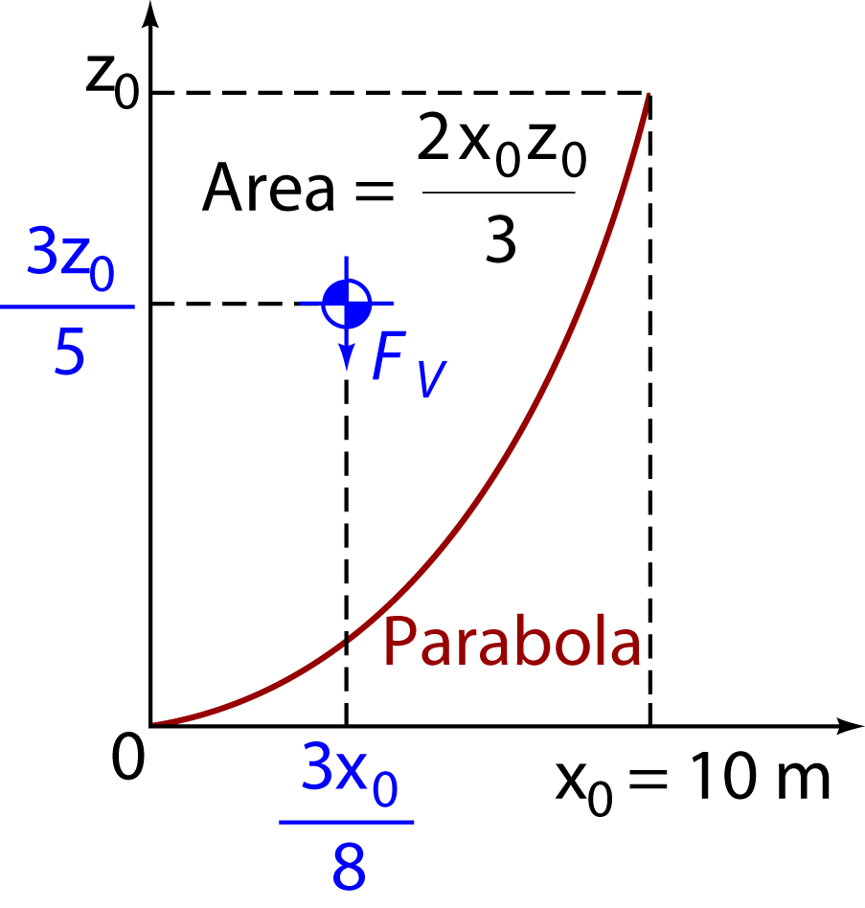
Example 3.5
F_{V} acts downward on surface at 3x₀/8 = 3.75 m from origin
Total resultant force on dam:
F = 3.232 x 10⁸ N
F acts down and to the right at angle of
F passes through (3.75 m, 8 m)
Notes:
Note center of mass is defined by
When the density is constant
In our case the center of mass (centroid) is located at

Slide 25
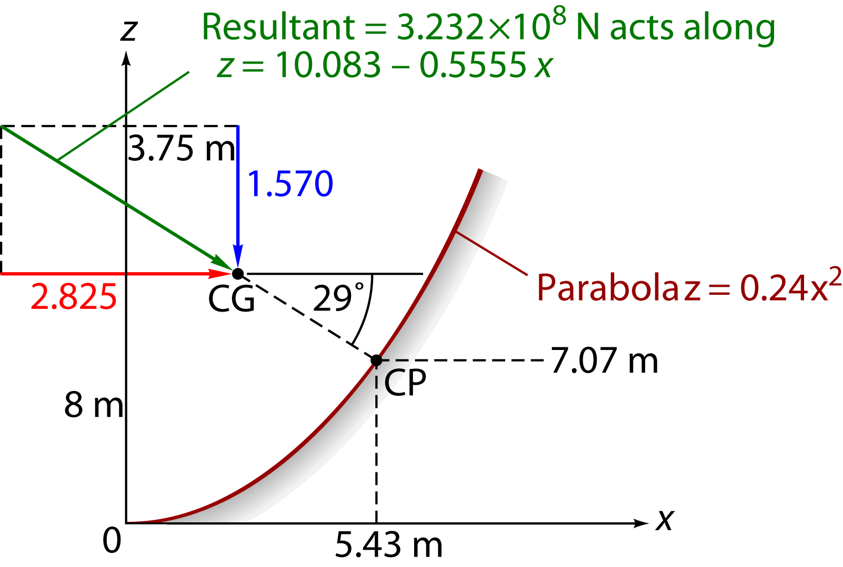
Example 3.5
Move down along 29º line until strike dam ⇨ equivalent center of pressure CP:
x_{CP} = 5.43 m
z_{CP} = 7.07 m

